Slide 1

Python
Programming with Python modes

Slide 2

Getting Started
First you need to download and install the latest version of Python from
https://www.python.org/downloads/
• The latest version is Python 3 and you can download the latest update in this version.

Slide 3
Python’s Integrated Development Environment (IDLE)
Build-in IDLE which is Python’s Integrated Development Environment. This can be used to write the Python code.
Starting the IDLE, the python will run interactive shell mode and ready to accept the
code and interprets it.

Slide 4
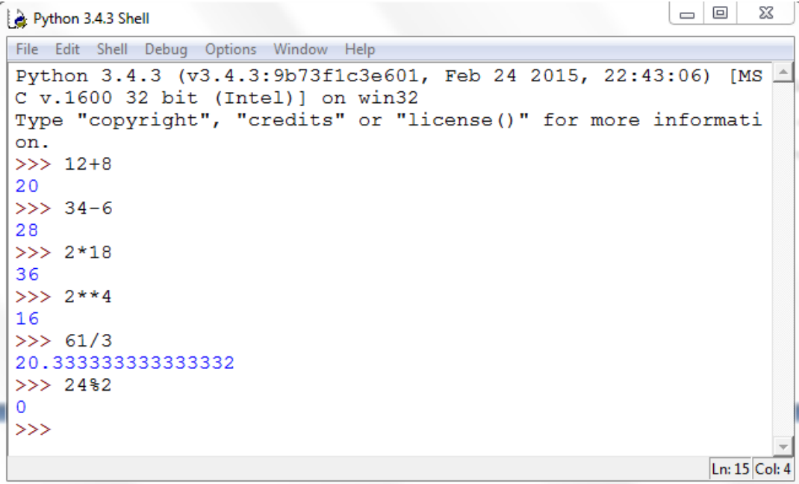
Using as Calculator
www.skillslash.com

Slide 5
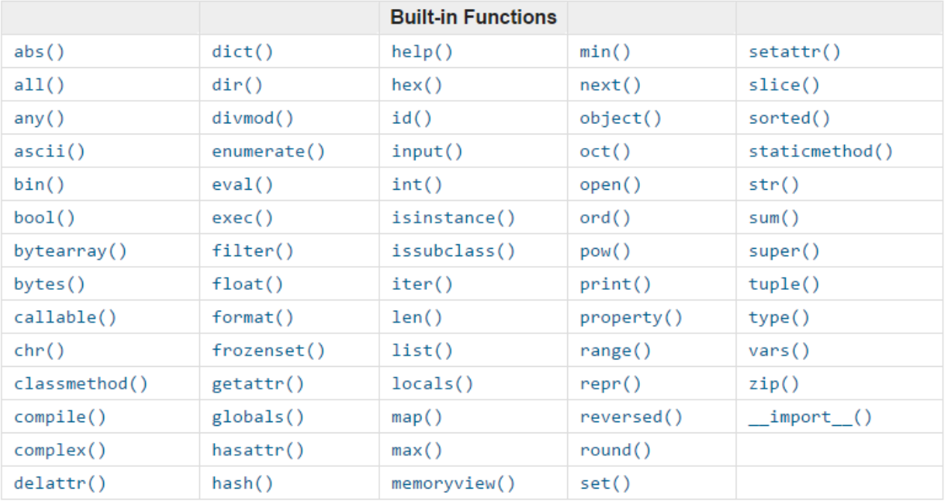
Python built-in functions
www.skillslash.com

Slide 6
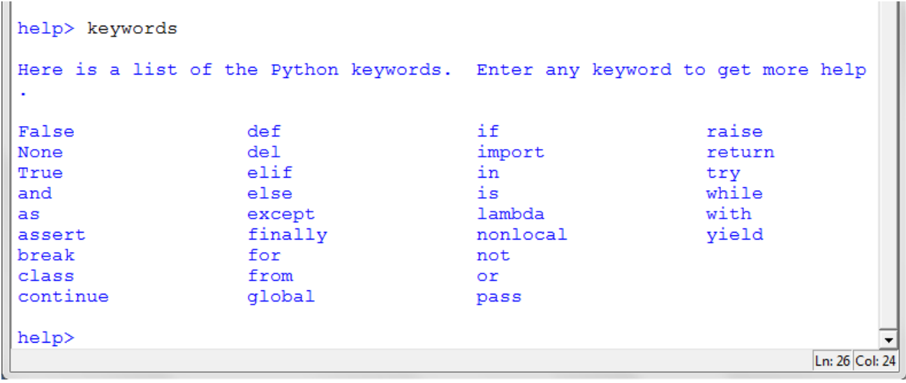
Keywords in Python
www.skillslash.com

Slide 7
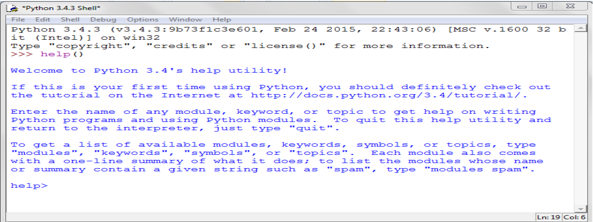
Help Utility
This built-in function help()will take you to the help mode of Python. It is a great help utility tool to know more about Python

Slide 8
Data Types in Python
In programming we categorise data into their specific types. You can use type() built-in function to get the data type of data. You need to place the data inside the parentheses of type().
Python has following data types that it uses to identify and categorise data.
String for any text
int for all integer numbers
float for all decimal numbers
bool for boolean values
Go the the Python IDLE shell mode and enter the following code.
type(“London”) - data type is str (String) means text.
type(34) - data type int (Integer) means whole number.
type(7.8) - data type is float means decimal number.
type(True) - data type is bool (Boolean) means boolean values.
type([]) - data type is list means collection.
type({}) - data type is dict means collection

Slide 9
THANK YOU
www.skillslash.com

